Slide 1
Inference Rules, Queries on Semantic Web

Slide 2
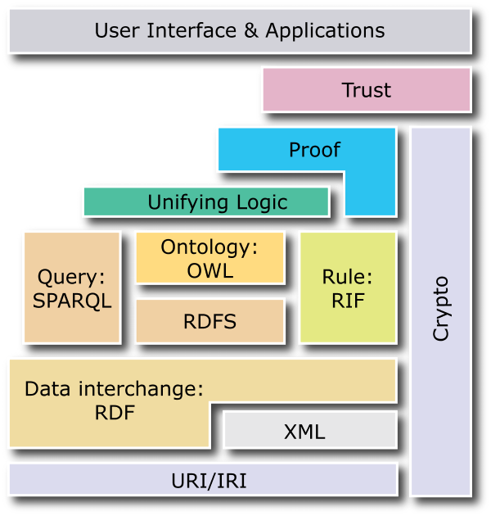

New Semantic « layer cake »
Notes:
Base layers
Base layers comprise the technological standards used in the upper levels:
Unicode to represent characters.
URI (Uniform Resource Identifier): compact string of characters used to identify or name a resource. The main purpose of this identification is to enable interaction with representations of the resource over a network, typically the WWW, using specific protocols. URIs are defined in schemes defining a specific syntax and associated protocols (definition from wikipedia).
XML (eXtended Markup Language) and related technologies, such as NS (Name Spaces) and XML Schema
RDF and RDF Schema.
As the cornerstone of information representation and exchange, RDF defines a simple model to describe any information. RDF is basically a labelled graph representation described by a set of triples (subject, predicate, object).
RDF can be serialized in XML (XML-RDF) but also in more compact formats such as Triples or N3.
RDF Schema extends RDF by adding extension to the basic vocabulary in order to be able to define Class, subClass, properties, subProperties, etc.
Ontology layer
An ontology is a specification of a conceptualization (more complete definition here). In few words, ontology gives the specification of a domain according to a given vocabulary. Usually we can assume that an ontology is defined by classes (objects), properties (attributes or relationships), instances and also various constraints.
Logic layer
Logic became an important aspect of ontologies. Ontology Web Language (OWL), one of the most spread ontology language, is based on Description Logics (DL), which gives high expressive level and provides sound and complete reasoning.
Proof layer
If we take the example of a transaction over the web: let's assume that a computer A send a bill to a computer B: "You owe me $20". Everybody expects the computer B won't give directly the money and say "Why? Prove it". And so the computer A could say: "you bought this book at this store and as you can see it is at this price". Additionally a rule saying that "_when you buy an item you have to pay it"_will finalize the proof. The point is that all these pieces of information are given by RDF triples with references to some URI, so the computer B can check them and if it trusts the referenced site, he can accept the proof. This example goes beyond some criticisms, notably coming the one from Google Executive, Peter Norvig, who challenged T. Berners-Leeduring a conference. It is true that with less human oversight lot of people would attempt to exploit the Semantic Web to make SPAM of get better result to sell you pills of any colored and so it could be difficult to trust such a web. But such comment forgets the concept of proof. Actually what is important is not to say it is the truth, but to give the basis for the other side to know whether this can be the truth according to its beliefs, like we do intuitively when we manually collect data from various location. So have a good grounding is the key: we give the source of the information, so people can decide to trust it or not.

Slide 3
Base Layer
Base Layer
Unicode to represent characters
XML defined in 1998 (syntactic interoperability) and related technologies, such as NS (Name Spaces) and XML Schema
URI (Uniform Resource Identifier): Identification of resources, generalization of URL
Crypto and security layers (HTTPS, etc.)
Notes:
Base layers
Base layers comprise the technological standards used in the upper levels:
Unicode to represent characters.
URI (Uniform Resource Identifier): compact string of characters used to identify or name a resource. The main purpose of this identification is to enable interaction with representations of the resource over a network, typically the WWW, using specific protocols. URIs are defined in schemes defining a specific syntax and associated protocols (definition from wikipedia).
XML (eXtended Markup Language) and related technologies, such as NS (Name Spaces) and XML Schema
RDF and RDF Schema.
As the cornerstone of information representation and exchange, RDF defines a simple model to describe any information. RDF is basically a labelled graph representation described by a set of triples (subject, predicate, object).
RDF can be serialized in XML (XML-RDF) but also in more compact formats such as Triples or N3.
RDF Schema extends RDF by adding extension to the basic vocabulary in order to be able to define Class, subClass, properties, subProperties, etc.
Ontology layer
An ontology is a specification of a conceptualization (more complete definition here). In few words, ontology gives the specification of a domain according to a given vocabulary. Usually we can assume that an ontology is defined by classes (objects), properties (attributes or relationships), instances and also various constraints.
Logic layer
Logic became an important aspect of ontologies. Ontology Web Language (OWL), one of the most spread ontology language, is based on Description Logics (DL), which gives high expressive level and provides sound and complete reasoning.
Proof layer
If we take the example of a transaction over the web: let's assume that a computer A send a bill to a computer B: "You owe me $20". Everybody expects the computer B won't give directly the money and say "Why? Prove it". And so the computer A could say: "you bought this book at this store and as you can see it is at this price". Additionally a rule saying that "_when you buy an item you have to pay it"_will finalize the proof. The point is that all these pieces of information are given by RDF triples with references to some URI, so the computer B can check them and if it trusts the referenced site, he can accept the proof. This example goes beyond some criticisms, notably coming the one from Google Executive, Peter Norvig, who challenged T. Berners-Leeduring a conference. It is true that with less human oversight lot of people would attempt to exploit the Semantic Web to make SPAM of get better result to sell you pills of any colored and so it could be difficult to trust such a web. But such comment forgets the concept of proof. Actually what is important is not to say it is the truth, but to give the basis for the other side to know whether this can be the truth according to its beliefs, like we do intuitively when we manually collect data from various location. So have a good grounding is the key: we give the source of the information, so people can decide to trust it or not.

Slide 4
RDF and RDF Schema Layers
RDF and RDF Schema
RDF: Resource Description Framework
RDF is the cornerstone of information representation and exchange
RDF defines a simple model to describe any information
(details next slides)
Notes:
Base layers
Base layers comprise the technological standards used in the upper levels:
Unicode to represent characters.
URI (Uniform Resource Identifier): compact string of characters used to identify or name a resource. The main purpose of this identification is to enable interaction with representations of the resource over a network, typically the WWW, using specific protocols. URIs are defined in schemes defining a specific syntax and associated protocols (definition from wikipedia).
XML (eXtended Markup Language) and related technologies, such as NS (Name Spaces) and XML Schema
RDF and RDF Schema.
As the cornerstone of information representation and exchange, RDF defines a simple model to describe any information. RDF is basically a labelled graph representation described by a set of triples (subject, predicate, object).
RDF can be serialized in XML (XML-RDF) but also in more compact formats such as Triples or N3.
RDF Schema extends RDF by adding extension to the basic vocabulary in order to be able to define Class, subClass, properties, subProperties, etc.
Ontology layer
An ontology is a specification of a conceptualization (more complete definition here). In few words, ontology gives the specification of a domain according to a given vocabulary. Usually we can assume that an ontology is defined by classes (objects), properties (attributes or relationships), instances and also various constraints.
Logic layer
Logic became an important aspect of ontologies. Ontology Web Language (OWL), one of the most spread ontology language, is based on Description Logics (DL), which gives high expressive level and provides sound and complete reasoning.
Proof layer
If we take the example of a transaction over the web: let's assume that a computer A send a bill to a computer B: "You owe me $20". Everybody expects the computer B won't give directly the money and say "Why? Prove it". And so the computer A could say: "you bought this book at this store and as you can see it is at this price". Additionally a rule saying that "_when you buy an item you have to pay it"_will finalize the proof. The point is that all these pieces of information are given by RDF triples with references to some URI, so the computer B can check them and if it trusts the referenced site, he can accept the proof. This example goes beyond some criticisms, notably coming the one from Google Executive, Peter Norvig, who challenged T. Berners-Leeduring a conference. It is true that with less human oversight lot of people would attempt to exploit the Semantic Web to make SPAM of get better result to sell you pills of any colored and so it could be difficult to trust such a web. But such comment forgets the concept of proof. Actually what is important is not to say it is the truth, but to give the basis for the other side to know whether this can be the truth according to its beliefs, like we do intuitively when we manually collect data from various location. So have a good grounding is the key: we give the source of the information, so people can decide to trust it or not.

Slide 5
Ontology representation languages
XML Schema: is not an ontology representation language in the conventional sense; but there are significant work in different domains to define industry, healthcare, etc. data models.
RDFS: RDF Schema is a semantic extension of RDF. It provides mechanisms for describing groups of related resources and the relationships between these resources.

Slide 6

RDF: Resource Description Framework
RDF defines data as a labeled graph
Define triples as < Subject, Predicate, Object >
Example:
train123 is_a Train
train123 has delay
delay reason delayReason1
Train
train123
is_a
reason
has
delay
delayReason1

Slide 7
RDF: Resource Description Framework
Semantics of RDF
Besides the graph structure, RDF does not bear any semantics, it is a neutral data representation
Any triple can be added, independently from the data structure
RDF allows fine grain integration of data
When XML allows integration at the document level
RDF allows integration on the statement level

Slide 8
The RDF Concepts and Abstract Syntax
rdfs:Resource
All things described by RDF are called resources, and are instances of the class rdfs:Resource.
This is the class of everything. All other classes are subclasses of this class.
rdfs:Resource is an instance of rdfs:Class.
rdfs:Class
This is the class of resources that are RDF classes.
rdfs:Class is an instance of rdfs:Class.
rdfs:Literal
The class rdfs:Literal is the class of literal values such as strings and integers.
Property values such as textual strings are examples of RDF literals.
Literals may be plain or typed. A typed literal is an instance of a datatype class. This specification does not define the class of plain literals.

Slide 9
The RDF Concepts and Abstract Syntax
rdfs:Datatype
rdfs:Datatype is the class of datatypes.
All instances of rdfs:Datatype correspond to the RDF model of a datatype described in the RDF Concepts specification.
rdf:Property
rdf:Property is the class of RDF properties. rdf:Property is an instance of rdfs:Class.

Slide 10
RDF Schema (RDFS)
The class and property concepts in RDF are similar to the type systems of object-oriented programming languages such as Java.
In object-oriented systems a class is usually defined in terms of the properties its instances may have.
In the RDF vocabulary properties are defined in terms of the classes of resource to which they apply.
This is the role of the domain and range mechanisms.
For example, we could define the eg:Author property to have a domain of eg:Article and a range of eg:Person.

Slide 11
RDF Schema (RDFS)
Serialization of RDF
In XML
<rdf:Description about=subject>
<predicate>objet</predicate>
</rdf:Description>
More efficient representation: store triples
{#subject #predicate #object}
RDFS: RDF Schema
Extends RDF with
Class,
Properties,
Sub-Class and Sub-Properties(Inheritance),
Instances

Slide 12
Property definition in RDFS
The RDF Concepts and Abstract Syntax specification describes the concept of an RDF property as a relation between subject resources and object resources.
This specification also defines the concept of subproperty.
The rdfs:subPropertyOf property may be used to state that one property is a subproperty of another.
The basic facilities provided by rdfs:domain and rdfs:range do not provide any direct way to indicate property restrictions that are local to a class.

Slide 13
Property definition in RDFS
rdfs:range
rdfs:range is an instance of rdf:Property that is used to state that the values of a property are instances of one or more classes.
rdfs:domain
rdfs:domain is an instance of rdf:Property that is used to state that any resource that has a given property is an instance of one or more classes.
More detailed syntax definitions are available at:
http://www.w3.org/TR/rdf-schema/
You need to be familiar with them but don’t need to remember all of them.

Slide 14
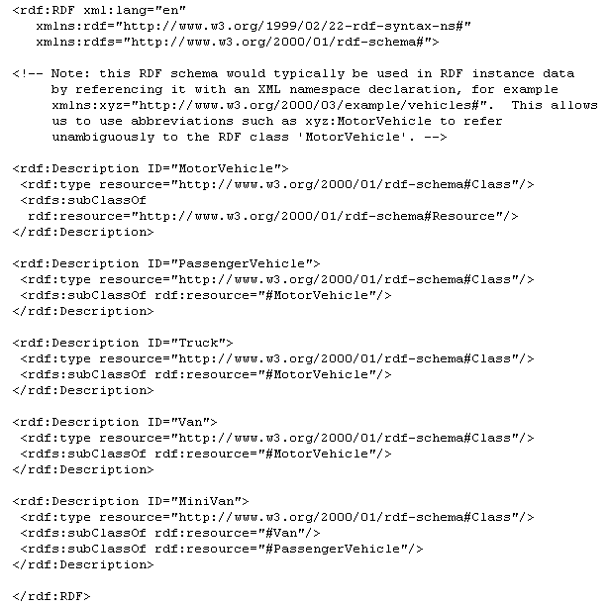
Example- RDFS/XML serialisation

Slide 15
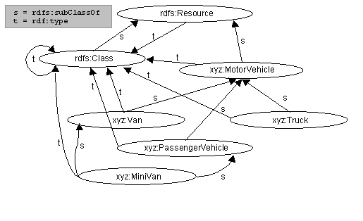
Example - class hierarchy
Source: http://www.w3.org/TR/2000/CR-rdf-schema-20000327/

Slide 16
RDFs : example
S : subClass-of
T : Instance-of
D: Domain R : Range
S
Rdfs:resource
S
Rdfs:Class
Rdf:Property
T
T
D
http://www.travel-ont.org/leaves-at
T
http://www.sncf.org/rdf/trains
S
T
R
T
http://www.ville.fr/rdf/département-rattachement
http://www.sncf.org/rdf/trains/ter
http://www.travel-ont.org/departure
http://www.sncf.org/rdf/trains/ter85158
http://www.travel-ont.org/leaves-at
http://www.travel-ont.org/departure
http://www.villes.fr/rdf/Grenoble
http://www.travel-ont.org/time
http://www.villes.fr/rdf/département-rattachement
13h27
http://www.villes.fr/rdf/Isère

Slide 17
RDFs : example
<rdf:Description ID="MotorVehicle">
<rdf:type resource="http://www.w3.org/...#Class"/>
<rdfs:subClassOf rdf:resource="http://www.w3.org/...#Resource"/>
</rdf:Description>
<rdf:Description ID="Truck">
<rdf:type resource="http://www.w3.org/...#Class"/>
<rdfs:subClassOf rdf:resource="#MotorVehicle"/>
</rdf:Description>
<rdf:Description ID="registeredTo">
<rdf:type resource="http://www.w3.org/...#Property"/>
<rdfs:domain rdf:resource="#MotorVehicle"/>
<rdfs:range rdf:resource="#Person"/>
</rdf:Description>
<rdf:Description ID=”ownedBy">
<rdf:type resource="http://www.w3.org/...#Property"/>
<rdfs:subPropertyOf rdf:resource="#registeredTo"/>
</rdf:Description>

Slide 18
OWL: Web Ontology Language
Ontology is:
“An explicit specification of a conceptualization” [Gruber93]
A formal specification of a given domain:
common understanding of a domain of interest
Formal and machine readable model of this domain
Different formalisms
OWL
F-Logic
Micro Concepts
etc.
Notes:
Ontology layer
An ontology is a specification of a conceptualization (more complete definition here). In few words, ontology gives the specification of a domain according to a given vocabulary. Usually we can assume that an ontology is defined by classes (objects), properties (attributes or relationships), instances and also various constraints.
Logic layer
Logic became an important aspect of ontologies. Ontology Web Language (OWL), one of the most spread ontology language, is based on Description Logics (DL), which gives high expressive level and provides sound and complete reasoning.

Slide 19
OWL: Web Ontology Language
OWL (2004)
Superseded OIL + DAML developed by DARPA
Standard language for ontology, defined on top of RDF
Represent structured knowledge
Defines rich semantics:
Define rich relationships (transitivity, symmetrical, etc)
Use logical constructs for class definitions (union, intersection, etc.)
Enable to create dynamic categories (restrictions based on description logics)
Three dialects:
OWL Lite: simplest OWL dialect
OWL DL (Description Logics): tractable fragment of First Order Logic.
OWL Full: roughly OWL DL with meta modeling

Slide 20
OWL: Example of ontology
Practically, it is composed of:
Concepts
And their hierarchy
Properties
Relationships
Relationships on relationships
Constraints and rules
Some instances
Name
Firstname
One person has 2 parents
hasParent
Inverse
Person
hasChildren
Subclass Of
Parent
Employee
One parent is a Person who has at least one child
John
onProperty :haschildren
owl:cardinality >1

Slide 21
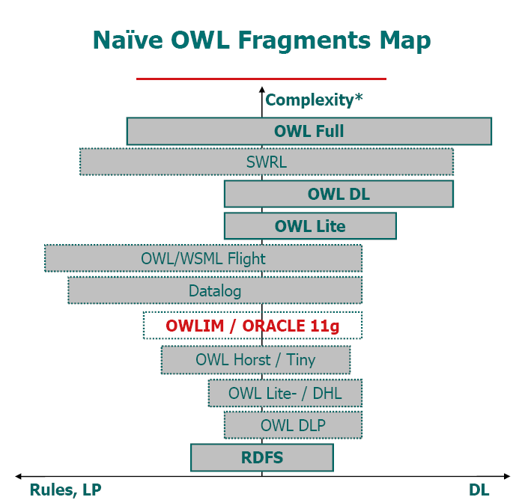
OWL 1: Description capabilities
OWL Full: Mainly address meta-modeling issues
OWL DL: Description Logics
OWL:ComplementOf, OWL:OneOf, OWL:Cardinality, OWL:DisjointWith, OWL:HasValue, OWL:DataRange
Undecidable
OWL Lite: add reasoning on individuals
OWL:FunctionalProperty, OWL:sameAs,OWL:InverseFunctionalProperty, OWL:Cardinality (0 or 1), OWL:allDifferent, OWL:differentFrom
****
DLP: Intersection of DL and LP (not in OWL Lite)
OWL:UnionOf
Class expression for rdfs:SubclassOf ,OWL:equivalentclass, OWL:IntersectionOf,
Decidable
***
DLP: Intersection of OWL Lite and LP
OWL:ObjectProperty,OWL:inverseOf, OWL:DatatypeProperty, OWL:TransitiveProperty, OWL:SymmetricProperty, OWL:allValuesFrom, OWL:someValuesFrom, OWL:equivalentClass, OWL:equivalentProperty,OWL:intersectionOF
**
*
Rdfs:subClassOf, rdfs:subPropertyOf, rdfs:domain, rdfs:range
[Illustration from OntoText, with some modifications]

Slide 22
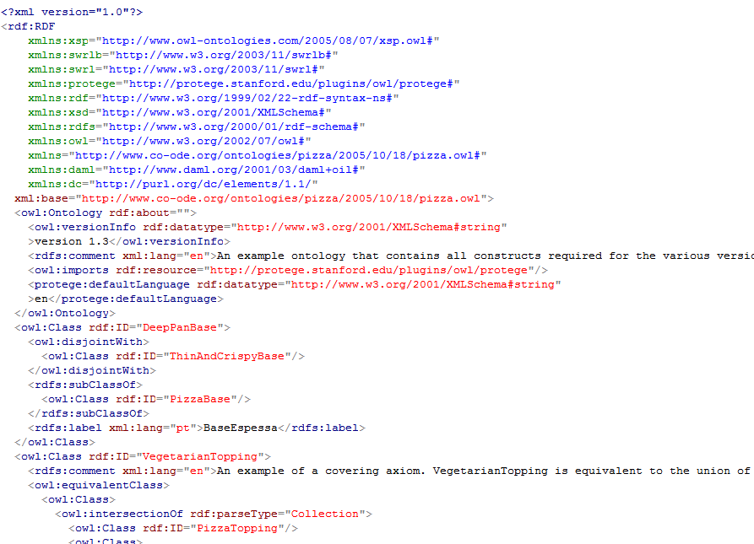
Example of an OWL Ontology in RDF-S

Slide 23
Example of an OWL Ontology in RDF-S
<owl:Class rdf:ID= "Latitude">
<rdfs:subClassOf rdf:resource="#MesureGeo" />
</owl:Class>
<owl:ObjectProperty rdf:ID="aEstimation">
<rdf:type rdf:resource="&owl;FunctionalProperty" />
<rdfs:domain rdf:resource="#LieuGeo"/>
<rdfs:range rdf:resource="#EstimationDeCrise"/>
</owl:ObjectProperty>
<owl:Class rdf:ID=« VilleNormale">
<owl:intersectionOf rdf:parseType="Collection">
<owl:Class rdf:about="#Ville" />
<owl:Restriction>
<owl:onProperty rdf:resource="#aEstimation" />
<owl:hasValue rdf:resource="#normal" />
</owl:Restriction>
</owl:intersectionOf>
</owl:Class>

Slide 24
OWL Lite (1)
RDF Schema Features:
Class
rdf:Property
rdfs:subClassOf
rdfs:subPropertyOf
rdfs:domain
rdfs:range
Individual
(In)Equality:
equivalentClass
equivalentProperty
sameAs
differentFrom
allDifferent
Property Characteristics:
inverseOf
TransitiveProperty
SymmetricProperty
FunctionalProperty
InverseFunctionalProperty

Slide 25
OWL Lite (2)
Property Type Restrictions:
allValuesFrom
someValuesFrom
Restricted Cardinality:
minCardinality (only 0 or 1)
maxCardinality (only 0 or 1)
cardinality (only 0 or 1)
Header Information:
ontology
imports

Slide 26
OWL Lite (3)
Class Intersection:
intersectionOf
Versioning:
versionInfo
priorVersion
backwardCompatibleWith
inCompatibleWith
DeprecatedClass
DeprecatedProperty
Annotation Properties:
rdfs:label
rdfs:comment
rdfs:seeAlso
rdfs:isDefinedBy
Datatypes
DatatypeProperty

Slide 27
OWL 2
OWL 2 (previously known as OWL 1.1)
Evolutions of OWL 1 about to be standardized
More pragmatic fragments, with polynomial complexity
OWL EL: for ontologies with many classes or properties
OWL QL: for large volumes of data and queries, can run on database systems
OWL RL: scalable reasoning without sacrificing too much expressive power, can be run on a rule engine

Slide 28
OWL: Reasoning
Use the semantics of the language (e.g. OWL) to derive new facts from the data according the ontology
SCHEMA (Tbox)
One person has 2 parents
hasParent
Inverse
Person
hasChildren
Subclass Of
Parent
Employee
One parent is a Person who has at least one child
Asserted facts (Abox)
hasChild
John
Alice
Infered facts (Abox)
John is_a Parent (because he has one Child)
John is_a Person (because he is a Parent)
Alice is_a Person (because she is a Child
but also because she is an Employee)
Alice hasParent John (because hasParent is inverse of hasChildren)

Slide 29
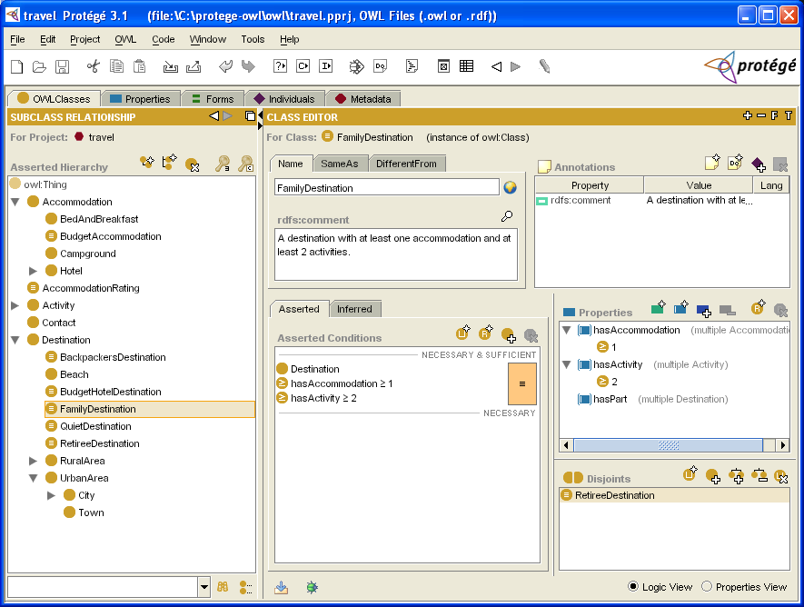
Protégé Ontology Editor (screenshot 1/2)

Slide 30
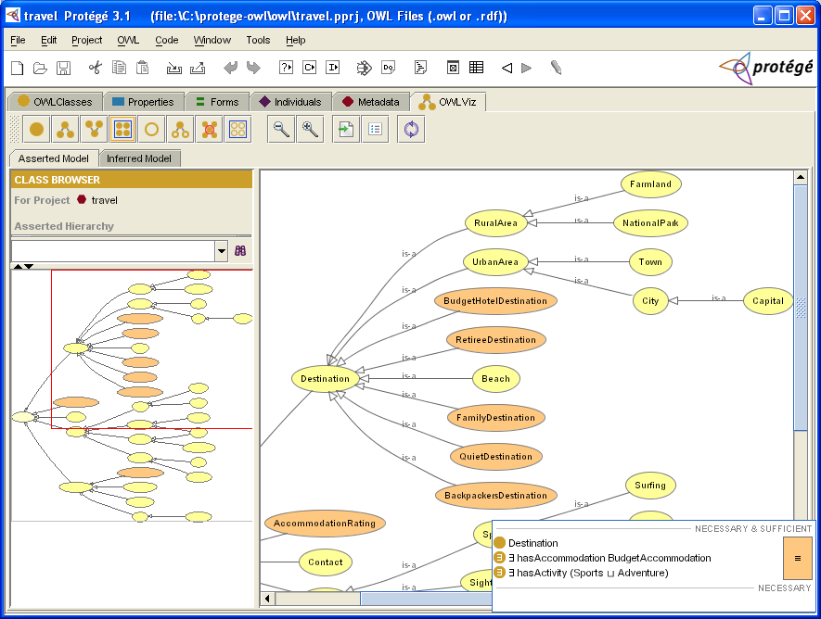
Protégé Ontology Editor (screenshot 2/2)

Slide 31
Rules Layer
Concepts= Person
O. pro = isancestor
Instance Person(x), Person(y), Person(z)
Rules
isancestor (x,y)
and
isancestor(y,z)
->
isancestor(x,z)
isancestor
y
x
isancestor
isancestor
z

Slide 32
Rules Layer
Rules
father (x,y)
and
brother(z,x)
->
uncle(z,y)
Is brother
x
z
Is father of
Is uncle of
y

Slide 33
Derivative Rules in OWL
Inference of new relations
relA(?x,?y) et relB(?i,?j) et relC (?k,?y) ➔ relD(?x,?j) et relF(?y,?i)
hasParent(?x1,?x2) ∧ hasBrother(?x2,?x3) ⇒ hasUncle(?x1,?x3)
Implies(Antecedent
(hasParent
(I-variable(x1) I-variable(x2))
hasBrother (I-variable(x2) I-variable(x3))
)
Consequent(
hasUncle(I-variable(x1) I-variable(x3))))

Slide 34
Semantic Web Rule Language (SWRL)
SWRL is based on a combination of the OWL DL and OWL Lite sublanguages of the OWL Web Ontology Language with the Unary/Binary Datalog RuleML sublanguages of the Rule Markup Language.
rules are of the form of an implication between an antecedent (body) and consequent (head).
The intended meaning can be read as: whenever the conditions specified in the antecedent hold, then the conditions specified in the consequent must also hold.

Slide 35
Semantic Web Rule Language (SWRL)
Atoms in SWRL rules can be of the form C(x), P(x,y), sameAs(x,y) or differentFrom(x,y),
where C is an OWL description, P is an OWL property, and x,y are either variables, OWL individuals or OWL data values.
https://www.w3.org/Submission/SWRL/

Slide 36
Semantic Web vs. Enterprise DB technologies
The main differences:
Semantic Web is designed for the Web
Based on Open World Assumption (OWA)
Everything is possible until the contrary is specified
OWA takes incomplete information as default
Unique name assumption is not the default case: i.e. two different instances can refer to the same object
Enterprise data usually use close world assumption (inherited from DB-World)
If a fact is not asserted, it is then false
Unique name assumption is the default, constraints can be checked before addition for consistency
Semantic Web technologies can be used in the enterprise keeping in mind this difference

Slide 37
DL Reasoning: General case (OWA, without UNA)
SCHEMA (Tbox)
hasParent
One person has 2 parents
Person
hasChildren
subClass of
Parent
Employee
Man
Woman
One parent is a Person who has at least one child
Disjoint
is a
Bob
hasParent
Same Individuals
Query answering
Is John an employee ?
Unknown
John
Robert
Mary
Has a child
« Semantic Web style » reasoning

Slide 38
DL Reasoning: General case (CWA, with UNA)
SCHEMA (Tbox)
hasParent
One person has 2 parents
Person
hasChildren
subClass of
Parent
Employee
Man
Woman
One parent is a Person who has at least one child
Disjoint
is a
Bob
hasParent
John
Robert
Inconsistency
Query answering
Is John an employee ?
False
Mary
Has a child
« Enterprise style » reasoning

Slide 39
Open vs. Close World Assomption
The main differences
Open World Assumption, e.g. Semantic Web:
Reasoning has high complexity (NExpTime-complete !)
Data can be inconsistent in some case
Closed World Assumption, e.g. Enterprise data:
Lighter Reasoning (Some well-chosen subsets have polynomial complexity)
Some logical constraints can be transformed to DB-like constraints.
Today : Semantic Web is hard to deploy on the WWW scope, but its technologies can already be used in the enterprise scope
Micro Concept is the selection of good axioms for this.

Slide 40
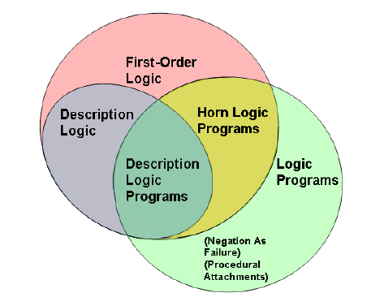
Reasoning with rules in ontology
Rules
Rule-based and Knowledge-based systems
A(?x) AND NOT C(?y) → INSERT H(“TOTO”)
Logic Programming
Logic Programs (Rules) and DL are disjoint
Different initiatives to combine rules and
ontology
RIF (Rule Interchange Format), 2009 (?)
SWRL (Semantic Web Rule Language)
Combine horn rules with OWL ontology
Can lead to indecidability
OWL DLP: Intersection of DL and LP
F-Logic : Object-oriented first-order logic (detailed in the following). Handle non-monotonic reasonign.

Slide 41
Micro-Concepts

Slide 42
Micro Concept Goals
Formal ontology but…
Business and ‘human understandable’ representation of a domain
Close-world assumption style reasoning: enterprise oriented
Constraints checked by the consistency engine
Reasoner handle by rules
Fast reasoning
Support of actions
Compatible with standards
XML/RDF/RDFS

Slide 43
Relations with other standards
OWL and OWL 2: More oriented towards open-world assumption
It is true new proposed OWL 2 supports lot of new features we needed in business use-cases
But still difficult to handle from business users
Based on RDF Schema
Serialization in RDF or RDF/XML

Slide 44
Relationship with other standards
Micro Concepts
Smart Rules
Notes:
Base layers
Base layers comprise the technological standards used in the upper levels:
Unicode to represent characters.
URI (Uniform Resource Identifier): compact string of characters used to identify or name a resource. The main purpose of this identification is to enable interaction with representations of the resource over a network, typically the WWW, using specific protocols. URIs are defined in schemes defining a specific syntax and associated protocols (definition from wikipedia).
XML (eXtended Markup Language) and related technologies, such as NS (Name Spaces) and XML Schema
RDF and RDF Schema.
As the cornerstone of information representation and exchange, RDF defines a simple model to describe any information. RDF is basically a labelled graph representation described by a set of triples (subject, predicate, object).
RDF can be serialized in XML (XML-RDF) but also in more compact formats such as Triples or N3.
RDF Schema extends RDF by adding extension to the basic vocabulary in order to be able to define Class, subClass, properties, subProperties, etc.
Ontology layer
An ontology is a specification of a conceptualization (more complete definition here). In few words, ontology gives the specification of a domain according to a given vocabulary. Usually we can assume that an ontology is defined by classes (objects), properties (attributes or relationships), instances and also various constraints.
Logic layer
Logic became an important aspect of ontologies. Ontology Web Language (OWL), one of the most spread ontology language, is based on Description Logics (DL), which gives high expressive level and provides sound and complete reasoning.
Proof layer
If we take the example of a transaction over the web: let's assume that a computer A send a bill to a computer B: "You owe me $20". Everybody expects the computer B won't give directly the money and say "Why? Prove it". And so the computer A could say: "you bought this book at this store and as you can see it is at this price". Additionally a rule saying that "_when you buy an item you have to pay it"_will finalize the proof. The point is that all these pieces of information are given by RDF triples with references to some URI, so the computer B can check them and if it trusts the referenced site, he can accept the proof. This example goes beyond some criticisms, notably coming the one from Google Executive, Peter Norvig, who challenged T. Berners-Leeduring a conference. It is true that with less human oversight lot of people would attempt to exploit the Semantic Web to make SPAM of get better result to sell you pills of any colored and so it could be difficult to trust such a web. But such comment forgets the concept of proof. Actually what is important is not to say it is the truth, but to give the basis for the other side to know whether this can be the truth according to its beliefs, like we do intuitively when we manually collect data from various location. So have a good grounding is the key: we give the source of the information, so people can decide to trust it or not.

Slide 45
Semantic Modeling – Flexible schema
According to the MOF (Meta Object Facilities, from the OMG group), modeling can be devided into abstraction levels.
In UML, only M0 can be changed at the execution, in ontogy M0 and M1 can be changed
RDF-RDFS
OWL
Ontology Models
RDF-RDFS
Micro Concepts
MC based models
Instance Data
Instance data
M3 - Meta Meta Model
M2 - Meta Model
M1 - Concepts
M0 - Data
MOF
UML
UML Models
Instances
ODM
Partial structural mapping
Mapping
Abstraction level
Variability (in OWL, Model is a data)

Slide 46
Micro Concept summary
A concept can be defined with the following elements:
Identification
Name / Domain
Localized Name and Description
Properties
Independent from concepts
Actions
Actions that a concept’s instance can perform
Takes arguments (input and output)
Parent concepts
Link a concept with
A literal
A concept
Support (qualified) constraints

Slide 47
Concept identification
UID:
An identifier unique within the concept ontology. We use URI.
Ontology:
The ontology domain where the concept is defined.
Localized Name :
A localized label may be assigned to the concept in any language supported by the concept.
Ex: Name(Eng) = Train, Name(Fra) = Locomotive
Localized Description :
An informal description about the object.
A description can be entered for any supported language.

Slide 48
Inheritance
A concept can be a sub-concept of another one or of several concepts.
The concept inherits from its parents concepts:
The properties and their constraints
The actions
Multiple inheritance is supported.
Properties have unique names, if properties have the same name in two inherited concepts, they are merged into the same property.
If actions have the same name in two inherited concept, they are considered different (unless the action is inherited by the two super concepts from the same super-super-concept).
Only restriction: there can’t be a cycle in the inheritances.
By default, a concept derives from the top concept ‘Object’.

Slide 49
Properties
Each concept or instance is described with properties.
A property links a concept instance to:
Another concept
A literal value
Properties are independent from concepts, they don’t belong to a concept definition.
Each concept instance can have any number of properties values of the same property.
A property doesn’t need to be declared in advance as part of the concept definition.
It can be declared in the concept definition, in particular to define qualified restrictions for the property (restriction valid if the property is associated with a given concept).

Slide 50
Literals
We can support the following types as data values:
Integer
Decimal
String
Enumeration
Date, Time, Date&Time
Boolean (native enumeration provided by the system)
Each enumeration is a new type defined by the user.
We can define value restrictions for integers, decimals and dates/times.

Slide 51
Properties definition
A property is defined by the following elements:
UID: Identifier for the property, unique in its ontology.
Ontology: used as container for a set of related micro-concepts.
Localized name(s) : The name of the property in every supported language.
Description(s) : a description for the object for every supported language.
Owner type (optional) : A restriction on the type of concept that can use this property. Can be multiple.
Value range (optional) : The type of the property value. Can be multiple¹.
The range of the property can be a literal or a concept.
If the range is a concept, the value of the property will be an instance of any sub-concept of the specified one. This value can be the top concept ‘Object’.
Domain and Range are structural constraints !
¹ In SEMbySEM, this value must be specified and must be unique.

Slide 52
Properties definition
Cardinality restriction (min/max values): structural constraints
Is Ordered: Indicates whether the instances of the property have an order.
Default Values: properties values associated to an instance whose concept uses this property.
Static Values: values that belongs to the domain concept definition instead of their instances. If one of these values is changed, then it’s changed for every instance of the domain concept.

Slide 53
Qualified properties
Constraints defined for a property can be overridden when used in a child concept of the property domain.
We can override:
Range: The range must be a sub-class of the range for the property in a more general context. This feature is not available for functional properties.
Minimum cardinality/Maximum cardinality: These restrictions must be more restrictive than the cardinality restrictions in a super-class.
Default values
Static values¹
¹ Static values cannot be overridden in SEMbySEM.

Slide 54
Properties inheritance
An ontology property can be declared as a sub property of another one (and only one).
Ex: The ‘HasWagon’ property can be declared as a sub-property of ‘HasPart’.
Some rules are imposed on this structure:
The owner of the property is a sub-concept of the owner of the base property.
If the value range of the parent property is a literal, the value range of the sub-property must be the same type.
If the value range of the parent property is a concept, the value range is a sub-concept of the parent property.

Slide 55
Property translation
We can indicate that a property represents the value of a sub property of a concept property.
Ex:
Engine has the property ‘Speed’
Train has the property ‘HasEngine’
We can define the property ‘Speed’ for the Train concept : Train.Speed = Train.HasEngine.Speed
We can define those properties using operators:
Train.Speed = average(Train.HasWagon.Speed)
Supported operators : sum, count, min, max, average
Can be extended (by plugins)
Train
Engine
HasEngine
Speed
Speed
…
Integer
(value)

Slide 56
Actions
This represents the actions that an instance of the concept can perform.
Ex: For a train engine : Start(), Stop()
An action is associated to a concept, and is only available for this concept and its sub-concepts.
Actions have some identification attributes like concepts and properties:
UID
Localized Name(s) and description(s)
An action is described as a concept, with properties that can be used as:
Input values
Output values
Any data

Slide 57
Instances
An instance is a concrete value associated to one concept.
Constant instances can be defined within the model.
It’s defined with
An UID
An ontology
Localized names
Localized descriptions
Properties values can be associated to an instance, as long as it respects its concept constraints.

Slide 58
Versioning
Version number can be added to each definition:
Concepts
Properties
Instances
When one of those terms are used, the user can specify the version of the term he’s using:
Concepts used in properties owner/value
Properties used in instances declaration
Concepts used in actions attributes

Slide 59
RULES

Slide 60
Rule: Introduction
Business Rules: "Business rule is a statement that defines or constrains some aspect of the business”
We Consider here the production rules
consisting of two parts:
a sensory precondition (or "IF" statement)
and an action (or "THEN").

Slide 61
Rule: Goal
Reuse: Use state-of-the-art rule production system (Drools, Jess, etc.) using RETE algorithm
Add semantics: express semantic business rules, that is to say rules related to Micro Concept
Define language and tools to benefit from existing algorithms and semantics

Slide 62
Examples of Semantic Rules (1)
Classical examples:
hasParent(?x1,?x2) ∧ hasBrother(?x2,?x3) ⇒ hasUncle(?x1,?x3)
Diamond Nixon: handle ambiguities
Exception: adding rules to define the priority-class to propagate behavior.
Obj[policy->P] :- Obj:Class, Class[policy*->P], not hasPriority(AnotherClass,Class)
or Use Salience if implemented
Republican
Quaker
[policy *-> nonpacifist]
[policy *-> pacifist]
Nixon
[policy *-> pacifist]

Slide 63
Conflicts between rules and semantics
Rules can affect semantics of the system
Inheritance + Rules conflict
Class definitions
d[m*->e]
b[m*->c]
Sub-Class
a:b
Rules
a:d :- a[m->c]
Smart Rules are based on Micro Concept but cannot change schema
b
[m*->c]
a
[m->c]
d
[m->e]
[m*->e]
Conflict: m has 2 values, then it is undefined

Slide 64
Relation with other standards
SQL Rules
PROLOG
DATALOG
Ontology + Rules (Such as OWL and SWRL)
FLogic
RIF (Rule Interchange Format)

Slide 65
Relation with other standards (2)

Slide 66
Language
Use Micro-Concept objects:
Concepts: ‘Transportation/Train’, ‘Transportation/MyStation’
Properties: ‘Transportation/HasWagon’
Instances: ‘Transportation/TGV1234’
Actions: ‘Transportation/Train/EmergencyStop’
Enumerations: ‘Network/ShutdownReason’
Enumeration values: ‘Network/ShutdownReason/Maintenance’

Slide 67
Rule formats
rule "ruleName"
[Attributes]
if
{
[Condition]
}
then
{
[Consequence]
}

Slide 68
Basic Rule Patterns
Train() //Match every instance of Train
The rule can declare that the instance must follow some properties restriction. The properties restrictions are located inside the match parenthesis, separated with commas.
Train(Speed > 300, Color == "blue")
If a property value has to be used in another matched pattern or in the rules consequence, the property value can be assigned in a variable:
Train(?speed := Speed)
The assigned variable can also be used in the current pattern:
Train(?s := Speed, ?s > 300)
The instance matched can also be assigned in a variable to be resued in another pattern or in the rules consequence:
?train := Train(Speed > 300, Color == "blue")
Remark: the rule will be reactivated everytime the value of a property in the pattern constraints changes. This is also true for a property value that is assigned to a variable, even if this variable isn’t resued in the consequence part. This can be an advantage or a drawback depending on the real purpose of the rule.

Slide 69
List Rule Patters
For properties with a multiple cardinality, two options are available:
Match every value of this property individually.
Train(?wagon := one(HasWagon)),
?wagon(Weight > 10)
In this case, the rule will be activated for every train, and for every wagon within this train whose weight is > 10.
Match every value of this property globally. The matched property can be used in the operations ‘not’, ‘exists’, and ‘forall’ to check a constraint on every value of a property.
Ex: Look every train containing at least one wagon whose weight is > 10:
Train(?wagons := all(HasWagon)),
exists(one in ?wagons(Weight > 10))
The rule is activated for every train matching the condition but not for every wagon within this train.
More patterns in the Rule document.
Notes:
Notice that in this case, we use a different syntax to match the wagons list (Wagon in wagons). This syntax must be used if and only if the variable contains a list of properties values, obtained with the all() operator.
Ex: Look every train that doesn’t contain any wagon whose weight is > 10:
Train(?wagons := all(HasWagon)),
not(one in ?wagons(Weight > 10))
The variable can be used without a ‘not’, ‘exists’ or ‘forall’ operator. This example is equivalent to the first example of this section:
Train(?wagons := all(HasWagon)),
one in ?wagons(Weight > 10)
However, the ‘all’ keyword should be used to test a property globally with a ‘not’, ‘exists’ or ‘forall’ operator. The following syntax is valid, but isn’t right:
Train(?wagon := one(HasWagon)),
exists(?wagon(Weight > 10))
//Match every train and every wagon such as the wagon has a weight > 10.
//The ‘exists’ is useless here.

Slide 70
Cardinality Restrictions
The condition can also be a restriction on a property cardinality (available only for properties with multiple cardinality):
Train(count(HasEngine)==0)
Train(count(HasEngine)<count(HasWagon))
The cardinality of the property can be stored in a variable if needed:
Train(?numWagons := count(HasWagon))

Slide 71
Property restrictions combination
If an instance matching has several properties constraints, they are linked with an implicit ‘and’ operator. It’s also possible to use explicitly ‘and’ and ‘or’ operators to combine properties constraints.
Train(Speed>100 or Weight>10)
Train(Platform == platform1, (ArrivesAt > time1 and ArrivesAt < time2)
or (LeavesAt > time1 and LeavesAt < time2))

Slide 72
Multiple Instance Matching
If a variable was created by assigning a property with multiple cardinality
one in ?wagons(Weight > 10)
Type overconstraint:
PassengerWagon in ?wagons(Weight > 10)
Assignment to variable:
?pWagon := PassengerWagon in ?wagons(Weight > 10)

Slide 73
Combination of base patterns
And (implicit)
t1:=Train( ?pos:=Position) and
t2:=Train(Position == ?pos)
Not
not(
?t1:=Train( ?pos:=Position) and
?t2:=Train(Position == ?pos, isnot( ?t1))
)

Slide 74
Combination of base patterns (2)
Exists
exists(Train(Position == MyStation))
The rule is activated if there is at least one train in ‘MyStation’
Forall
forall ( ?t:=Train(Position == MyStation); Train ?t(Speed == 0))
The rule is activated if every train in ‘MyStation’ is stopped.

Slide 75
Combination of base patterns (3)
Is not
?t1:=Train( ?pos:=Position),
?t2:=Train(Position == ?pos, isnot( ?t1))
Other conditions
Expressions with arithmetic operators.
Comparison operators.
And/Or operators.

Slide 76
Consequence
Instance creation/removal
createInstance(FireAlarm);
Train ?newTrain;
?newTrain:=createInstance(Train);
removeInstance(?oldTrain);
RemoveInstance(‘Transportation/tgv4567’)

Slide 77
Consequence (2)
Property value update
?train1->TrainNumber := ?calculatedNumber;
?train1->’Transportation/Train/Speed’ := ?train1->HasEngine->Speed;
Property value creation/removal
Available for non functional properties
For non ordered properties:
addPropertyValue(?train1->HasWagon, ?wagonInStock);
addPropertyValue(?train1->HasWagon, ‘Transportation/MyStation/Wagon9875’);
For ordered properties
insertPropertyValue(?train1->HasWagon, ?wagonInStock, 0);
insertPropertyValue(?train1->HasWagon, ‘Transportation/MyStation/Wagon9875’, 0);

Slide 78
Consequence (3)
Property value removal
Only available for non functional properties.
removePropertyValue(?train1->HasWagon, ?wagonInStock);
removePropertyValue(?train1->HasWagon ,’Transportation/MyStation/Wagon9875’);
For ordered elements:
removePropertyValueAt(?train1->HasWagon, 0);
removePropertyValueAt(?train1->HasWagon, -1); //remove the last element
To remove every properties
removeAllPropertyValues(?train1->HasWagon);

Slide 79
Consequence (4)
Action on an Instance
CreateAction
execute( ?train1,’Transportation/Train/EmergencyStop’);
‘Network/Actions/Shutdown’ ?shutdownAction := createAction(?proxyServer, ‘Network/Actions/Shutdown’);
?shutdownAction->Reason := ‘Network/ShutdownReason/Maintenance’;
execute(?shutdownAction);
Calling Java method

Slide 80
QUERY with SPARQL

Slide 81
SPARQL
SPARQL is the query language to search resource & value;
It is based on matching graph patterns ( like RDF triple pattern, but the resource and value can be variable)
?res uni:phone ?pho
use “?” to define variable, for both string and numeric type
Like in SQL, it has a Select-From-Where structure.

Slide 82
SPARQL
An Example
PREFIX rdf: < http://www.w3.org/1999/02/22-rdf-syntax-ns# >
PREFIX uni:<http://www.mydomain.org/uni-ns#>
(namespace make quries shorter and easier to read)
Select ?X
Where
{
?x uni: phone : 520-543-2340.
}

Slide 83
SPARQL
An Example
Select ?X ?Y
Where
{
?x uni: phone ?y
}

Slide 84
SPARQL
An Example
Select ?name ?Y
Where
{
?X rdf:type uni:Lecturer;
uni: name ?name.
?X uni: phone ?Y.
}

Slide 85
SPARQL
An Example
Select ?name ?Y
Where
{
?X rdf:type uni:Lecturer;
uni: name ?name.
?X uni: phone ?Y.
OPTIONAL{?X uni:phone ?Y}
}

Slide 86
SPARQL
An Example
Select ?Y
Where
{
?X rdf:type uni:Lecturer;
uni: name :David Bill.
?C uni: phone ?Y.
Filter(?X=?C)
}

Slide 87
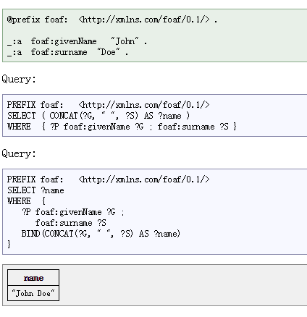
SPARQL

Slide 88
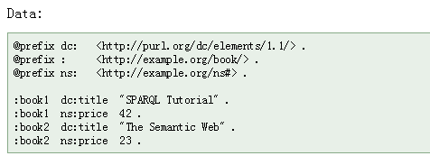
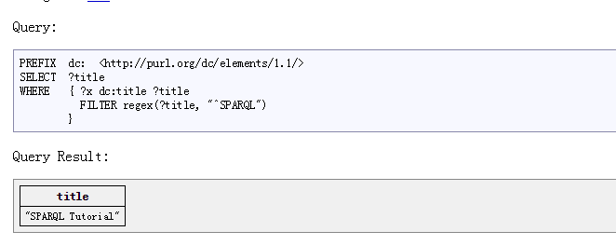
SPARQL

Slide 89
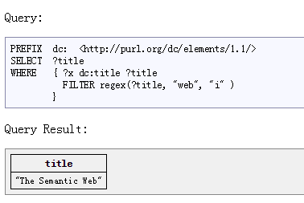
SPARQL

Slide 90
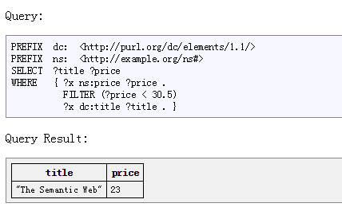
SPARQL

Slide 91
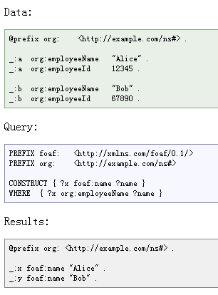
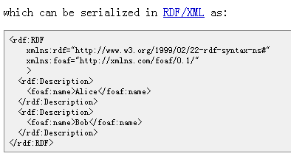
SPARQL
SPARQL has several query forms.
The CONSTRUCT query form returns an RDF graph.

